Slide 1



Song Recommender
Alex Ferrer | Minh Nguyen | Francisco Caupers

Slide 2

Song Recommender Analysis
1
Data-Driven Approach
Uses Spotify's API for a rich and detailed data source.
2
Data Analysis
Involves analyzing audio features to understand and categorize songs effectively.
3
Sophisticated System
Focuses on developing an advanced music recommendation system
4
Personalization
Aims to match user preferences with song characteristics for better music discovery and personalization.

Slide 3


Objective and Background
Objective
Background
The objective is to develop an advanced recommendation algorithm to cater to the diverse tastes of music listeners, ultimately enhancing user experience and engagement.
Explore the rich landscape of music data and its complexities to gain insights into user preferences, thus facilitating informed decision-making in music recommendations.

Slide 4






The Dataset
Diverse Datasets
We use two different datasets for comprehensive coverage.
Dataset Size and Variety
The original 'not hot' songs dataset contained approximately 23,000 rows, providing a rich and diverse selection base.
'Not Hot' Songs Data
2800 random tracks from a dataset with songs from 1950 to 2019, encompassing a variety of genres and styles.
'Hot' Songs Data
Tracks selected from the Billboard Hot 100 list, representing current popular music trends.
Objective
The varied dataset selection method aims to make the recommendation system robust and versatile, catering to a broad spectrum of musical preferences.

Slide 5

Spotify Collaboration and Market Research
Spotify Collaboration
Market Research Findings
Focus on Song Features
Filling the Gap
Addresses the gap in current music platforms by categorizing songs based on intrinsic qualities, not just popularity.
The project utilizes Spotify's extensive database for a wide variety of music genres and listener preferences.
Emphasizes song-based clustering with a specific focus on danceability, energy, acousticness, key, valence.
Identified a niche in existing music platforms, noting the prevalence of artist-based clustering and the relative lack of song-based clustering.
Enhanced Discovery Experience
Aims to offer a richer, more personalized music discovery experience by considering songs musical qualities.

Slide 6
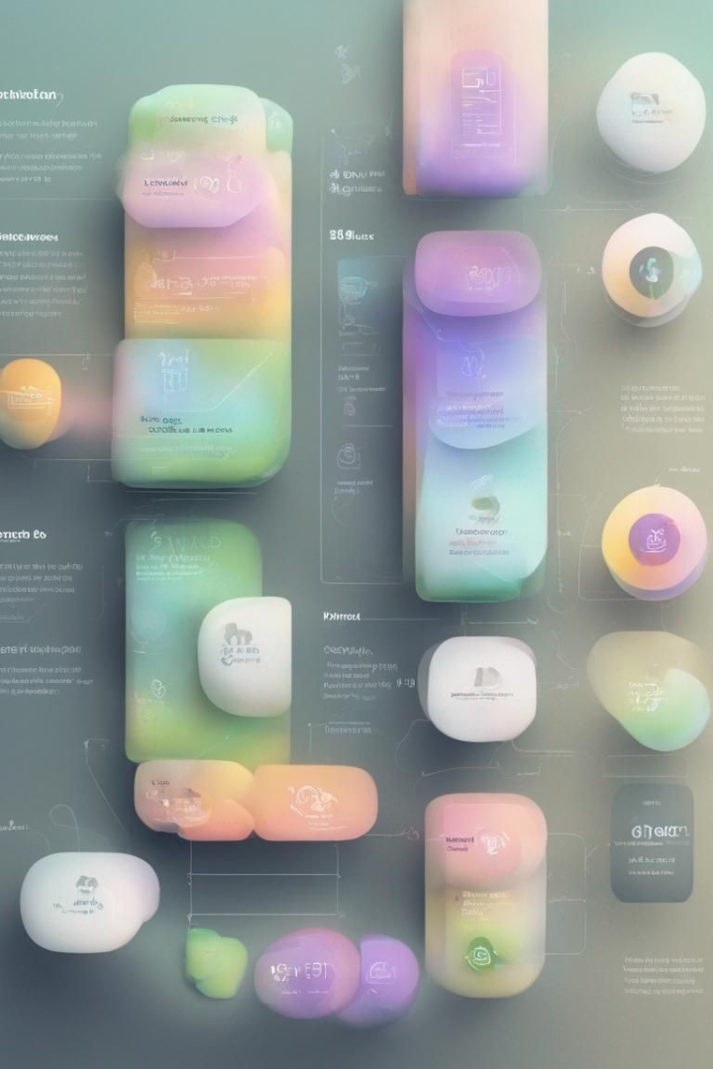
Song Clustering and Features
Our method goes beyond the traditional 'hot or not' classification, providing a more nuanced view of a song's appeal. By focusing on song-based clustering and analyzing audio features such as energy and danceability, our system uncovers deeper insights into what makes a song resonate with listeners. This approach not only categorizes songs by their popularity but also highlights their unique musical qualities, enriching the music discovery and recommendation experience

Slide 7
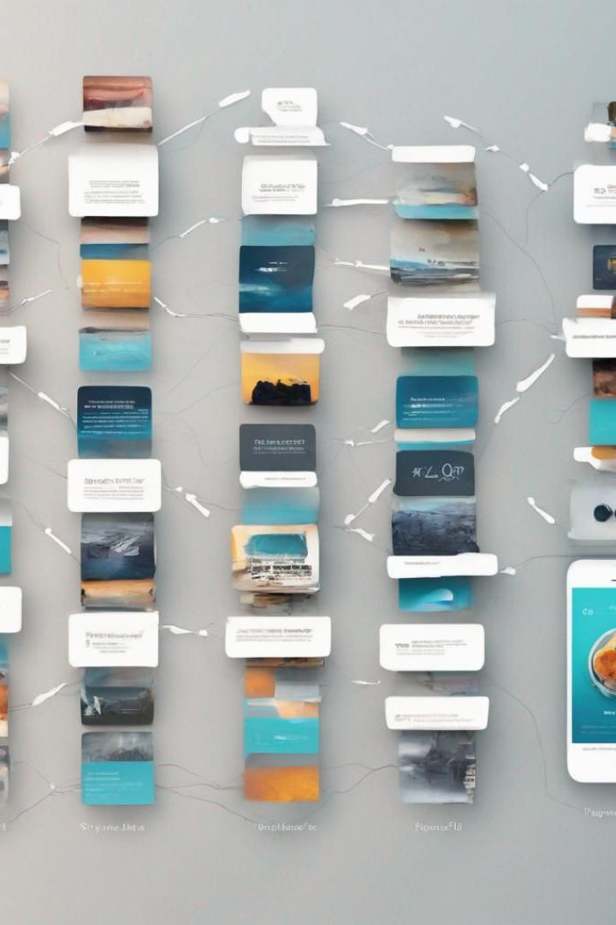



Future Directions
Broader Data Integration
Dynamic Recommendations
Incorporate diverse data sources like social media trends and user listening patterns.
Aiming for more dynamic and responsive song recommendations based on these broader data inputs
User Interface Enhancement
Focus on upgrading the user interface to be more engaging and intuitive.

Slide 8


Conclusion
Key Takeaways
Overall, our methodology offers a powerful solution for music recommendation systems. By leveraging advanced data analysis techniques and Spotify's API, we're able to deliver personalized recommendations that users love. Whether you're a casual listener or a die-hard music enthusiast, our approach is tailored to meet your unique needs.

